Slide 1
Regression: explaining
and predicting a number
How much does one thing change when another changes, and how well can a model predict it?
AI and Data Science Professional | Session 13 of 24 | Module C: Analyse and explain
KLAi Professional Learning | Jotham Martin Wambi
Notes:
Welcome back. Over the last twelve sessions you learned to load data, clean it, query it, chart it and test whether a gap is more than luck. Today the question gets bigger. When footfall rises, rainfall changes or a promotion runs, how many more orders does a branch get?
That is regression. You will fit a model to the Lakeside Mart weekly data, read every number in it as a sentence, check where it fails, and say what it does not prove.

Slide 2



Today in one view: what you will leave with
By the end of today you can
Fit a simple and a multiple linear regression by ordinary least squares, and read each coefficient as a sentence a manager can use
Judge a model with residuals, R squared and a residual plot, and put a category into a model with indicator variables
Say what a regression can predict, what it can explain, and what it cannot prove
Notes:
Here is what you can do by the end of today. You can fit a regression line, and a regression with several predictors, by ordinary least squares, and then read each coefficient as one plain sentence for a manager. You can judge the model with residuals, R squared and a residual plot, and you can put a category such as the branch into a model with indicator variables.
And you can say what the model predicts, what it explains, and what it cannot prove. Today is also Project milestone 2, a one page analysis report that you show me for feedback, and you write your project question before you leave.

Slide 3

Your two hours: concepts first,
then a Python regression lab
Ideas with pictures first. Then you open the notebook, fit the model and write your one page report.
Notes:
We have two hours. The first ten minutes bring back Session 12 and set the question for today. Then forty-five minutes of concepts with no laptops open, so you can follow the pictures. After a ten minute break we open a Colab notebook for the forty-five minute lab.
In every step you predict first, run the cell, read the output and change one thing. The last ten minutes are an exit check and what you keep, including your one page report for Project milestone 2.

Slide 4

Three questions from last time
1. A 95 percent confidence interval for a lift includes zero. What do you tell the manager?
2. A p-value is tiny. Does that make the effect big?
3. What does the standard error measure?
Answer aloud first. Then we check together.
Notes:
Three quick questions from Session 12. Answer aloud first, and then we check together. It is a warm-up to bring last time back.
Question one. A 95 percent confidence interval for a lift includes zero. What do you tell the manager?
A good answer is this. We cannot tell yet whether the lift is more than sampling variability. The data are compatible with a gain, with no change and with a loss.
Question two. A p-value is tiny. Does that make the effect big?
A good answer is this. No. The p-value says a gap this size is unlikely if nothing is going on. The effect size says whether the gap matters.
Question three. What does the standard error measure?
A good answer is this. How much a statistic, such as a sample mean, varies from one sample to the next. It shrinks as the sample grows.
If you missed one, check your notes from last session tonight. Now to today.

Slide 5



Answers to the three questions from Session 12
Question | Short answer
A 95 percent confidence interval for a lift includes zero. What do you tell the manager? | We cannot tell yet whether the lift is more than sampling variability. The data are compatible with a gain, with no change and with a loss.
A p-value is tiny. Does that make the effect big? | No. The p-value says a gap this size is unlikely if nothing is going on. The effect size says whether the gap matters.
What does the standard error measure? | How much a statistic, such as a sample mean, varies from one sample to the next. It shrinks as the sample grows.
Notes:
Here are the answers to the three warm-up questions. If the interval for a lift includes zero, you tell the manager that the data cannot yet separate a gain from no change or a small loss. A tiny p-value says a gap this big would be rare if nothing were going on, but only the effect size says whether the gap is big enough to matter.
And the standard error measures how much a statistic such as a sample mean varies from sample to sample. Every regression coefficient also comes with a standard error and an interval, so today you use all three ideas again. Which one needed the most thought?

Slide 6





Words we use today
Word | What it means
Regression (linear regression model) | A model that predicts a numeric target as an intercept plus a weighted sum of predictors. Ordinary least squares (OLS) finds the weights.
Coefficient and intercept | The coefficient is the change in the prediction for one more unit of a predictor, with the other predictors held fixed. The intercept is the prediction when every predictor is 0.
Residual (prediction error) | Actual value minus predicted value for one record. OLS minimises the sum of the squared residuals.
R squared (coefficient of determination) | The share of the variation in the target that the model accounts for, from 0 to 1.
Indicator variable (dummy variable) | A variable that is 1 when a record belongs to a category and 0 otherwise. One-hot encoding makes one for each level.
Notes:
Five words for today. I give the plain meaning of each, and we use every one of them before the end of the session.
Regression (linear regression model). A model that predicts a numeric target as an intercept plus a weighted sum of predictors. Ordinary least squares (OLS) finds the weights.
Coefficient and intercept. The coefficient is the change in the prediction for one more unit of a predictor, with the other predictors held fixed. The intercept is the prediction when every predictor is 0.
Residual (prediction error). Actual value minus predicted value for one record. OLS minimises the sum of the squared residuals.
R squared (coefficient of determination). The share of the variation in the target that the model accounts for, from 0 to 1.
Indicator variable (dummy variable). A variable that is 1 when a record belongs to a category and 0 otherwise. One-hot encoding makes one for each level.

Slide 7
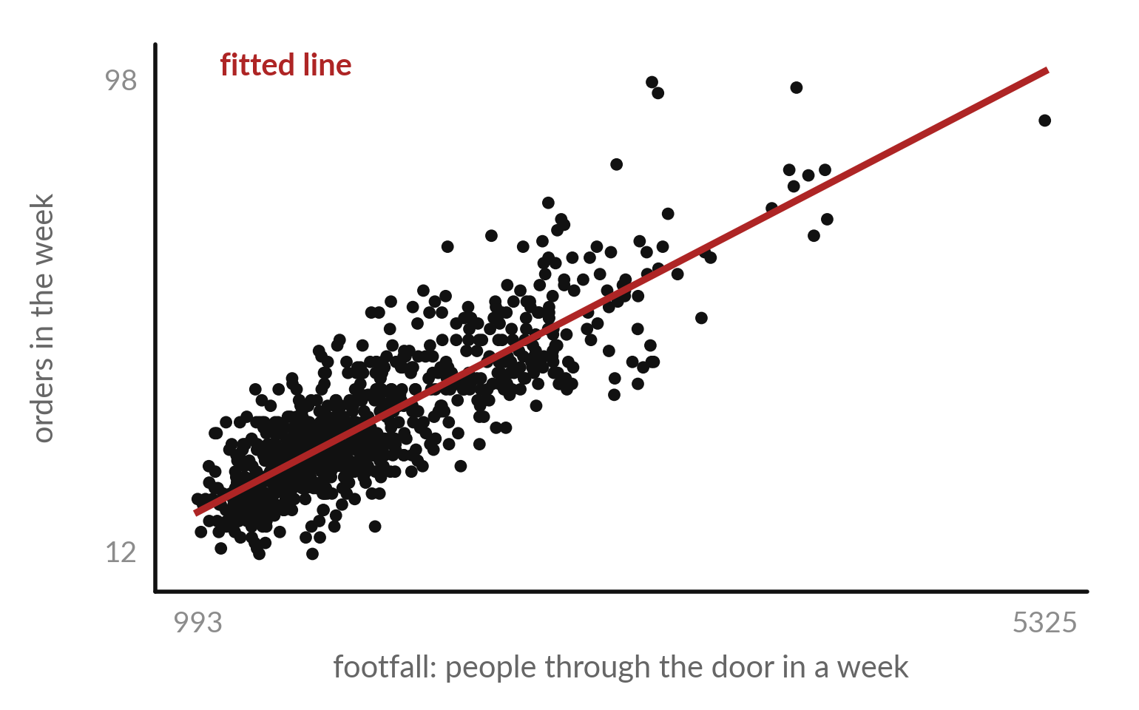
Regression fits a line through a
cloud: weekly orders against footfall
A scatter plot has one dot for each record: one branch in one week.
832 dots, one for each record.
Along the bottom: footfall, the predictor (independent variable).
Up the side: orders, the target (dependent variable).
Notes:
Today we answer a question you meet at work all the time. When one thing goes up, how much does another change?
In Excel you would draw a scatter chart and add a trendline. That trendline is a regression. Each dot is one record, one Lakeside Mart branch in one week, so there are 832 dots. Footfall, the count at the door, runs along the bottom. It is the predictor, also called the independent variable or the feature.
Orders run up the side. That is the target, also called the dependent variable or the response. The red line is the fitted line, the model. Busy weeks sit high and to the right, and the correlation is 0.84. What would the line tell a manager that the correlation alone does not?

Slide 8





The Excel word, the statistics word and
the machine learning word for each part
In Excel | In statistics | In machine learning
Trendline on a scatter chart | Linear regression model | Model (regressor)
The x column | Independent variable (predictor) | Feature
The y column | Dependent variable (response) | Target
SLOPE and INTERCEPT | Coefficient and intercept | Parameters (weights and bias)
RSQ, or R2 on the trendline | R squared | Score (model.score)
A row | Observation | Instance (record)
LINEST is the Excel function that fits several predictors at once. This course uses predictor and target from here on.
Notes:
You already know every part of a regression from Excel, so here is the translation. The trendline on a scatter chart is a linear regression model. The x column is the independent variable, also called the predictor, and in machine learning the feature. The y column is the dependent variable, also called the response, and in machine learning the target.
SLOPE and INTERCEPT give the coefficient and the intercept, which machine learning calls the weights and the bias. RSQ gives R squared. Excel also has LINEST, which fits several predictors at once. From here on I say predictor and target. Which of these words was new to you?

Slide 9
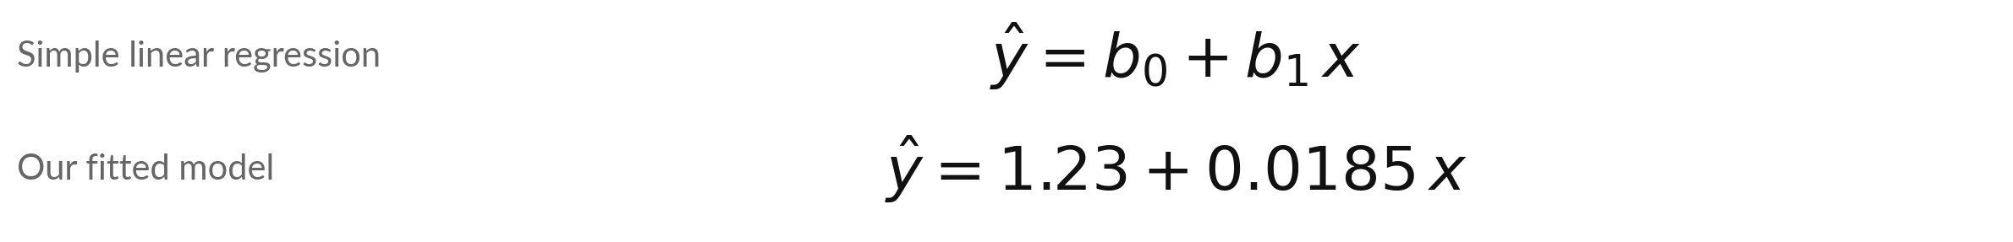
Simple linear regression is a formula with
two numbers: an intercept and a coefficient
Symbol | What it means | In our data
y-hat | The predicted target. | orders in a week
x | The predictor. | footfall, 993 to 5,325 people
b0 (intercept) | The prediction when x is 0. | 1.23 orders
b1 (coefficient) | The change in the prediction for one more unit of x. | 0.0185 orders per person
1,000 more people at the door goes with about 18.5 more orders. R squared is 0.706, the correlation 0.84 squared.
Notes:
The fitted line is a formula. The predicted target, y hat, equals b zero plus b one times x. B zero is the intercept, the prediction when the predictor is zero. B one is the coefficient, the slope: how much the prediction changes for one more unit of x.
For our data b zero is 1.23 and b one is 0.0185 orders per person. That is a small number, so we multiply by a thousand: a thousand more people at the door goes with about 18.5 more orders. With footfall alone, R squared is 0.706, which equals the correlation squared.
Why would a manager prefer the sentence about a thousand people?

Slide 10
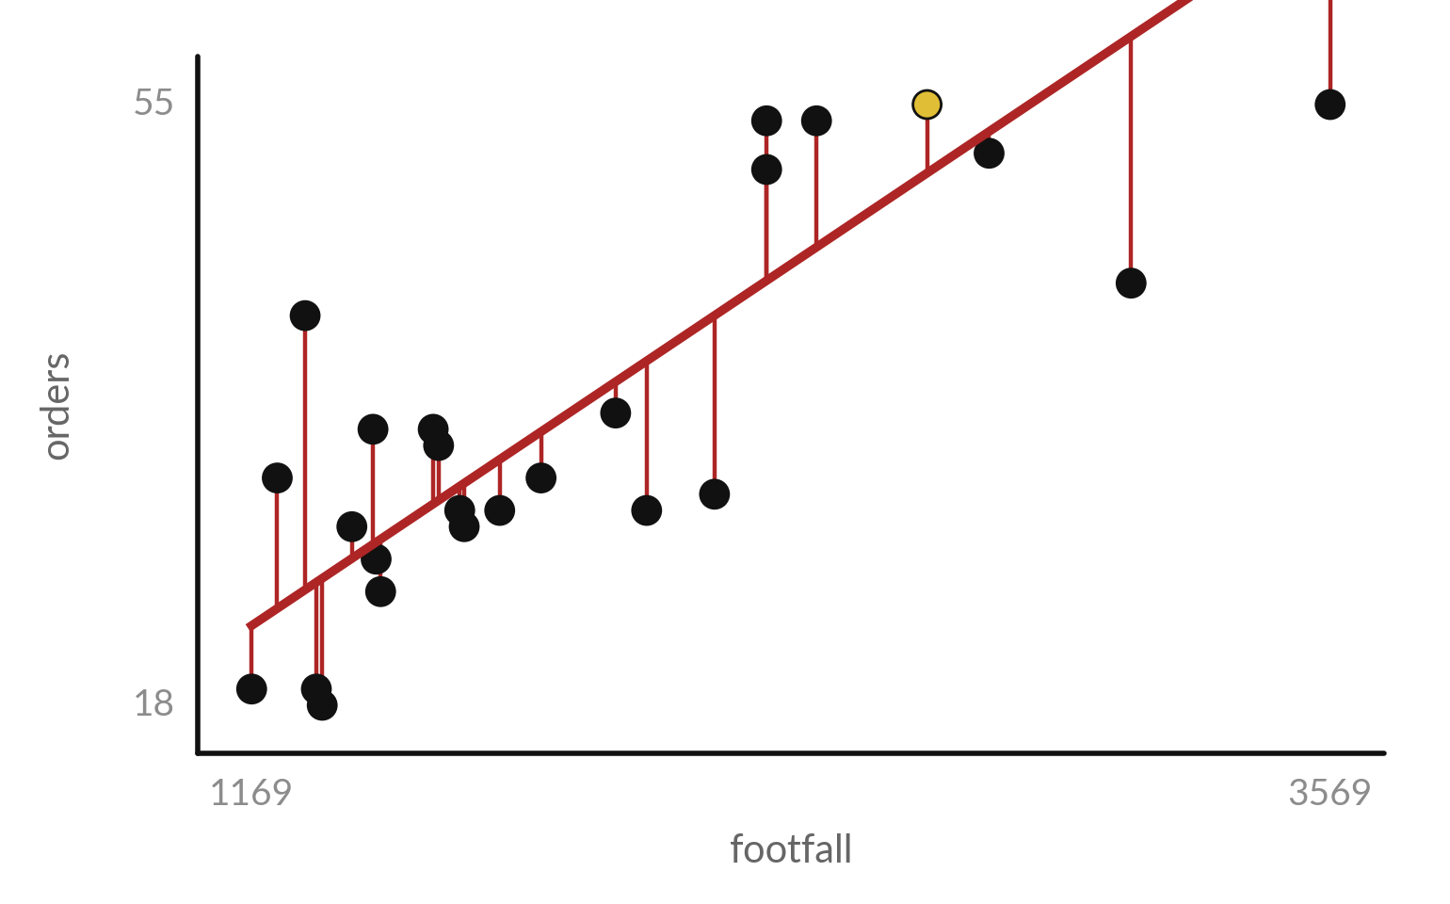
A residual is the actual value
minus the predicted value
Each red segment is one residual: how far the line misses one record.
Residual: e = y minus y-hat. Above the line it is positive.
Gold dot: B01, week of 2024-01-01. Actual 55 orders, predicted 50.8, residual +4.2.
25 of the 832 records are drawn.
Notes:
A model is never perfect, so we measure how far it misses. The gap between a dot and the line is the residual, also called the prediction error. It is the actual value minus the predicted value. A dot above the line gives a positive residual. The gold dot is the first record in the file: branch B01, the week of 2024-01-01, with 2,672 people.
The line predicts 50.8 orders, the actual number was 55, so the residual is +4.2. I drew only twenty-five of the eight hundred and thirty-two records so you can see the segments. Is the gold dot above or below the line?

Slide 11
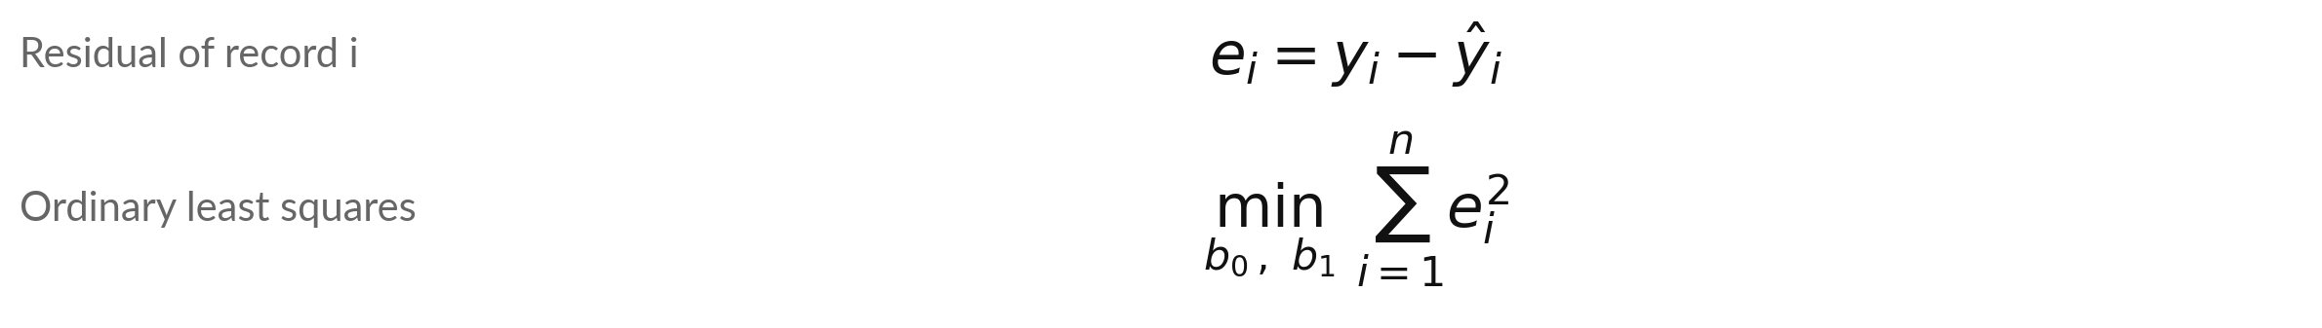
Ordinary least squares picks the line with
the smallest sum of squared residuals
Symbol | What it means | In our data
e_i | The residual of record i. | +4.2 for record 1
y_i and y-hat_i | Actual and predicted target of record i. | 55 and 50.8
n | The number of records. | 832
sum of e_i squared | Add the squared residuals of all n records. | 43,930 for our line
A rival line with slope 0.015 (and its own best intercept) gives a sum of 47,780. OLS finds the smallest sum: 43,930.
Notes:
How does the computer choose the line?
Try any line through the cloud. Every dot sits above or below it, and each gap is a residual. We square every residual so that misses above and below both count, and we add them up. That total is the sum of squared residuals. The method called ordinary least squares, or OLS, finds the b zero and b one that make this sum as small as possible.
A rival line with a slope of 0.015, and its own best intercept, gives 47,780. The OLS line gives 43,930, the smallest possible. Excel does the same thing when you add a trendline. Why do we square the residuals instead of just adding them?

Slide 12
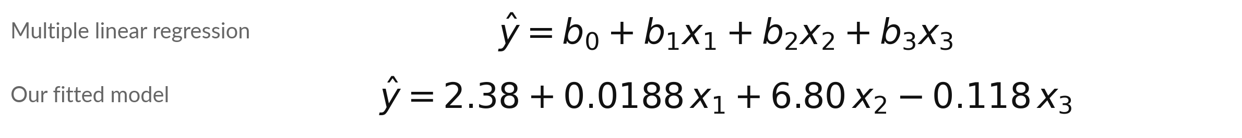
Multiple linear regression adds
predictors: footfall, promotion and rainfall
Symbol | What it means | In our data
x1 | footfall, people through the door. | 0.0188 orders per person
x2 | promo_on: 1 in a promotion week, 0 otherwise. | 6.80 orders
x3 | rainfall_mm, millimetres of rain in the week. | -0.118 orders per mm
b0 | The intercept. | 2.38 orders
One least squares rule finds all four numbers. statsmodels and scikit-learn give the same numbers as NumPy.
Notes:
Real weeks have more than one influence, so we add predictors. This is multiple linear regression: the prediction is an intercept plus one coefficient for each predictor. Multivariate means several targets, so we say multiple. Our model has three predictors: footfall, promo on, which is one in a promotion week, and rainfall in millimetres.
Ordinary least squares finds all four numbers together: 2.38, 0.0188, 6.80 and -0.118. NumPy solves them with matrix algebra, and libraries such as statsmodels and scikit-learn return the same numbers. In your own words, what does the minus sign on rainfall say?

Slide 13




Read each coefficient as one sentence,
with its 95 percent confidence interval
Term | Coefficient | 95% interval | As a sentence
Intercept | 2.38 | 0.91 to 3.84 | The starting level. No week has zero footfall (the minimum is 993), so do not read it alone.
footfall | 0.0188 | 0.0181 to 0.0195 | 1,000 more people at the door goes with 18.8 more orders, other predictors held fixed.
promo_on | 6.80 | 5.79 to 7.80 | A promotion week has 6.8 more orders than a week without one at the same footfall and rain.
rainfall_mm | -0.118 | -0.136 to -0.100 | 10 mm more rain goes with 1.2 fewer orders, other predictors held fixed.
Interval = coefficient plus or minus 1.963 standard errors (Student t, 828 degrees of freedom).
Notes:
Now the skill your manager cares about: reading each coefficient as a sentence. Footfall: a thousand more people at the door goes with 18.8 more orders, holding promotion and rain fixed. Holding the others fixed is part of the meaning, so always say it. Promotion: a promotion week has 6.8 more orders than a week without one, at the same footfall and rain.
Rainfall: ten millimetres more rain goes with 1.2 fewer orders. Each coefficient has a 95 percent confidence interval, built from its standard error as in Session 12. None of the intervals includes zero. Which sentence would you put on a slide for your manager?

Slide 14
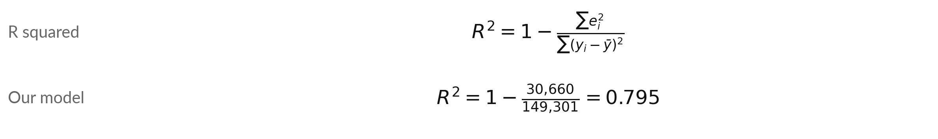
R squared is the share of the variation in
the target that the model accounts for
Symbol | What it means | In our data
sum of e_i squared | Sum of squared residuals: what the model leaves unexplained. | 30,660
sum of (y_i - y-bar) squared | Total variation of the target around its mean y-bar. | 149,301
Adjusted R squared | R squared with a penalty for each extra predictor. | 0.794
Footfall alone gave 0.706. RMSE (6.1 orders) is the typical miss, weighting big misses more.
Notes:
How good is the fit?
R squared, also called the coefficient of determination, compares two totals. The top is the sum of squared residuals, what the model leaves unexplained, 30,660. The bottom is the total variation of the target around its mean, 149,301. One minus that ratio is 0.795, so the model accounts for about 79 percent of the variation in weekly orders.
Adjusted R squared, 0.794, penalises extra predictors. The root mean squared error, RMSE, is 6.1 orders: the root of the mean squared residual, a typical size of a miss that weights big misses more. For comparison, the same predictors give R squared 0.357 for sales in shillings, because a few huge baskets add variation that footfall cannot explain.
What does an R squared of zero mean?

Slide 15
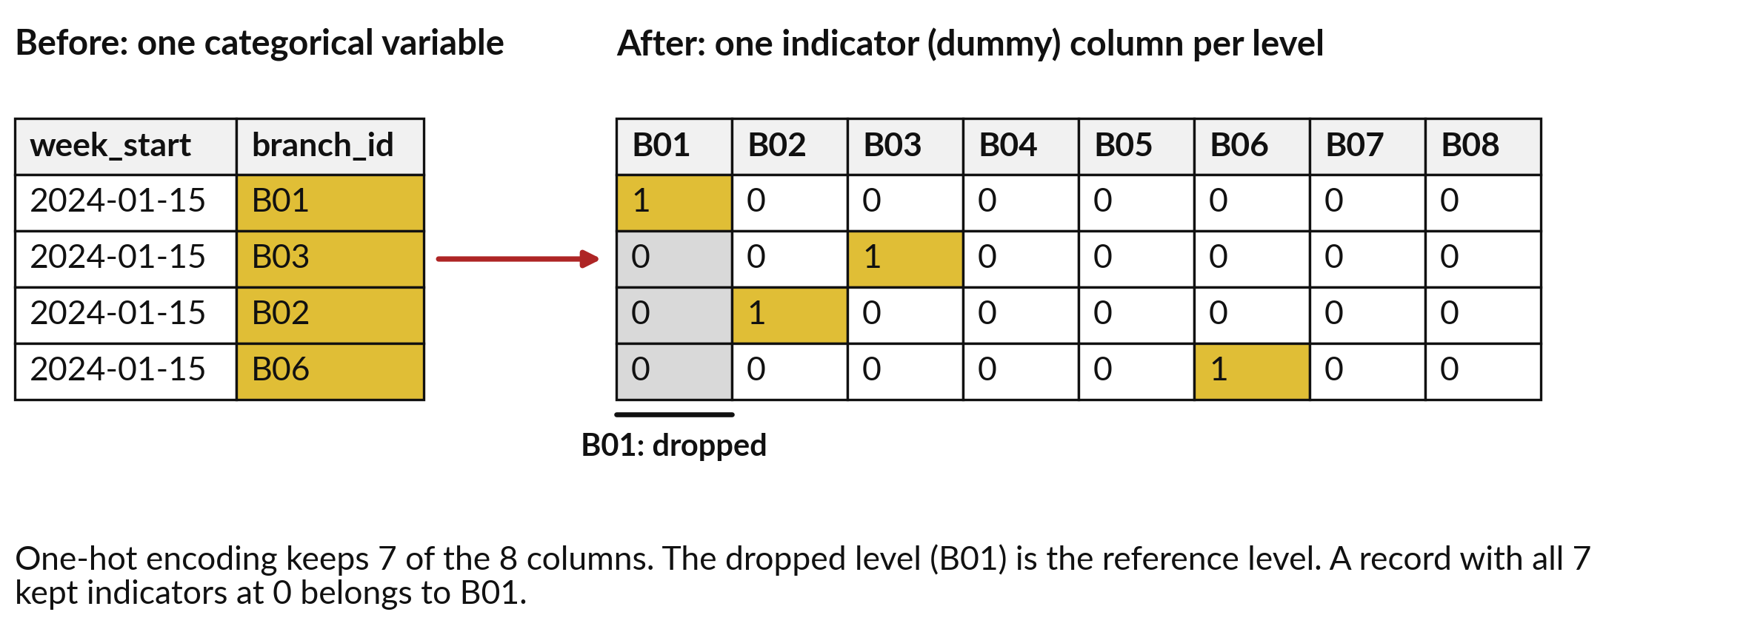
A category enters a regression as indicator
(dummy) variables: one-hot encoding
promo_on is already an indicator variable. branch_id has 8 levels, so we make 8 columns and keep 7.
Notes:
A regression needs numbers, so a category such as the branch has to be turned into numbers. The standard way is an indicator variable, also called a dummy variable: a column that is one when the record belongs to a category and zero otherwise. Making one such column for every level is called one-hot encoding.
The promotion column is already an indicator. Branch has eight levels, so we get eight columns, and each record has a single one. We keep only seven. The dropped level, B01, becomes the reference level, and the other seven coefficients compare each branch with B01. Why can we drop one column without losing any information?

Slide 16
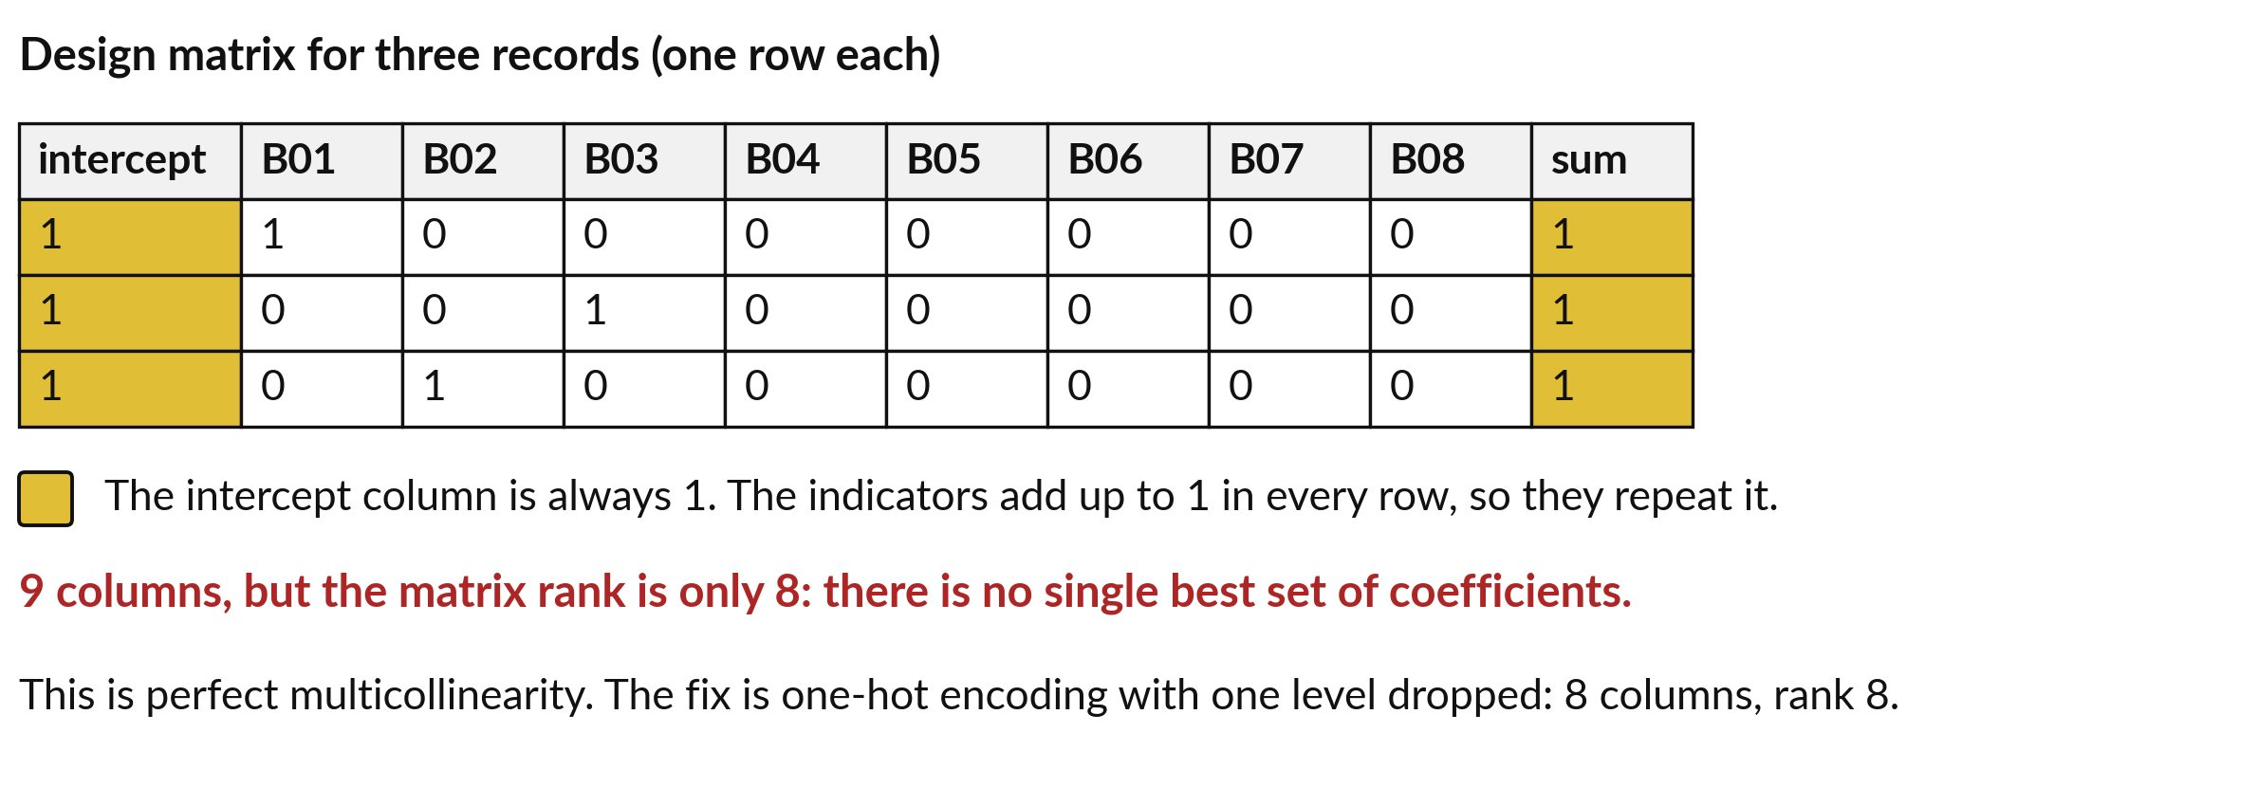
Keep all eight indicators and the intercept and the
model cannot be solved: the dummy variable trap
Perfect multicollinearity: one column is a copy of the sum of others.
Notes:
Here is a classic trap. Put the intercept column and all eight branch indicators into the model. In every row the eight indicators add up to one, which is exactly the intercept column. One column repeats the sum of the others. This is perfect multicollinearity, and it is called the dummy variable trap.
The matrix has 9 columns but its rank is only 8, so many different sets of coefficients fit equally well and the computer cannot choose. The fix is the one you saw on the last slide: drop one level. Libraries such as pandas do this with drop first.
What would the coefficient of the dropped branch be?

Slide 17


Seven branch indicators barely change the fit:
R squared 0.796, and adjusted R squared falls
Model | Predictors | R squared | Adjusted R squared
Footfall only | 1 | 0.706 | 0.705
Footfall, promotion, rainfall | 3 | 0.795 | 0.794
Plus 7 branch indicators (B01 is the reference level) | 10 | 0.796 | 0.793
R squared never falls when you add a predictor. Adjusted R squared falls when the new predictor adds too little. At the same footfall, promotion and rain, B02 has 0.82 fewer orders than B01.
Notes:
Let us see what the branch indicators do. With footfall alone R squared is 0.706. With promotion and rainfall it is 0.795. Adding seven branch indicators lifts it only to 0.796. R squared can never fall when you add a predictor, so it flatters big models. Adjusted R squared charges a penalty for each predictor, and it falls from 0.794 to 0.793.
That is the signal that the branch indicators add too little. The branches differ a little: B02 has 0.82 fewer orders than B01 at the same footfall, promotion and rain. Footfall already carries most of the difference between branches. Would you keep the indicators?

Slide 18
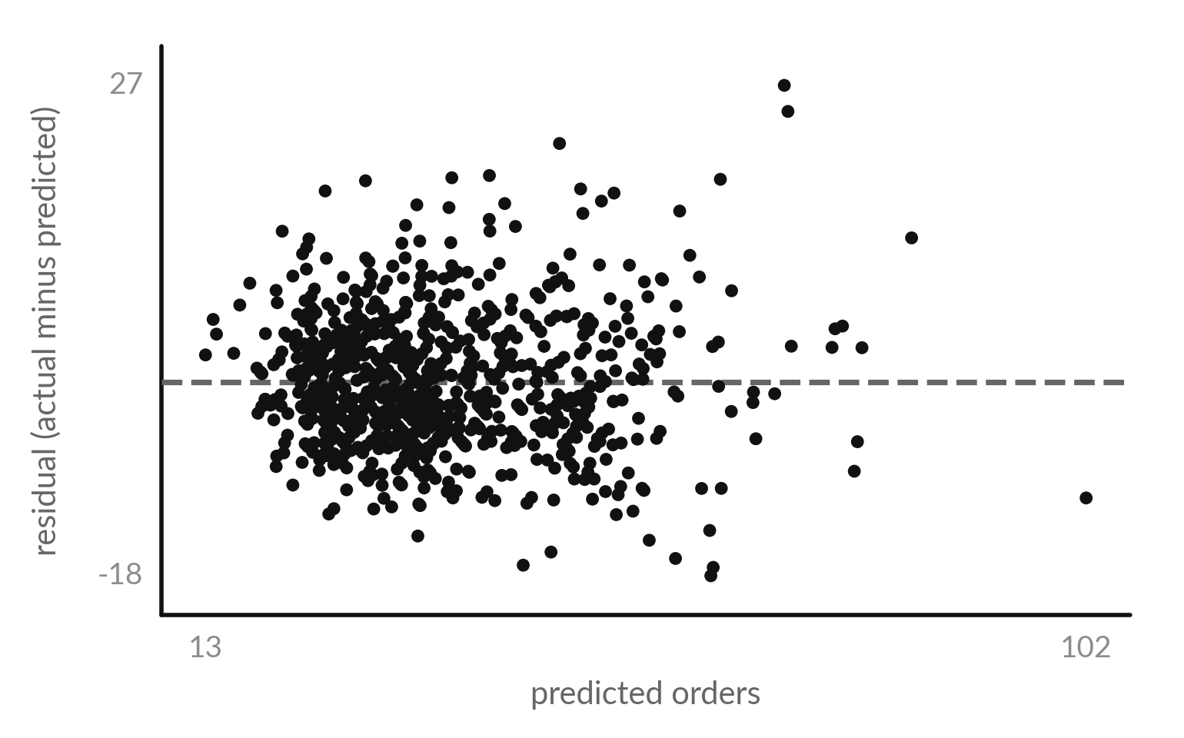
A residual plot should show an
even cloud: homoscedasticity
Homoscedasticity: the residuals have the same spread at every prediction.
Ours grows: standard deviation 5.2, 5.6, then 7.2 orders, low to high thirds.
A fan shape: mild heteroscedasticity.
Intervals for busy weeks are too narrow.
Notes:
A residual plot puts the predicted value along the bottom and the residual up the side. If the model is sound, the dots form an even cloud around zero, with the same spread everywhere. That property is called homoscedasticity. Our plot fans out a little to the right.
Split the predictions into three equal groups, from low to high, and the standard deviation of the residuals is 5.2, 5.6 and 7.2 orders. That is mild heteroscedasticity: busy weeks are harder to predict than quiet ones, so a confidence interval that treats every week alike is too narrow for busy weeks.
What would you tell a manager about forecasts for busy weeks?

Slide 19

Four patterns in a residual plot
and what to do about each
Pattern | What it means | What to try
An even cloud around zero | The straight-line model and constant spread look reasonable. | Report the model with its limits.
A curve, like a smile | The relationship is not a straight line. | Add a squared term or change the variable.
A fan that widens (heteroscedasticity) | The error grows with the size of the prediction. | Model the log of the target, or report wider intervals for large predictions.
A few dots far from the rest | Outliers or data errors. | Check those records. Do not delete without a reason.
Notes:
Learn to read four patterns. An even cloud around zero means the straight-line model and the constant spread look reasonable. A curve, like a smile, means the true relationship bends, so add a squared term or change the variable. A fan that widens is heteroscedasticity. The error grows with the size of the prediction, so model the log of the target or report wider intervals for large predictions.
And a few dots far from the rest are outliers or data errors, so check those records and never delete them without a reason. Which pattern did our plot show?

Slide 20
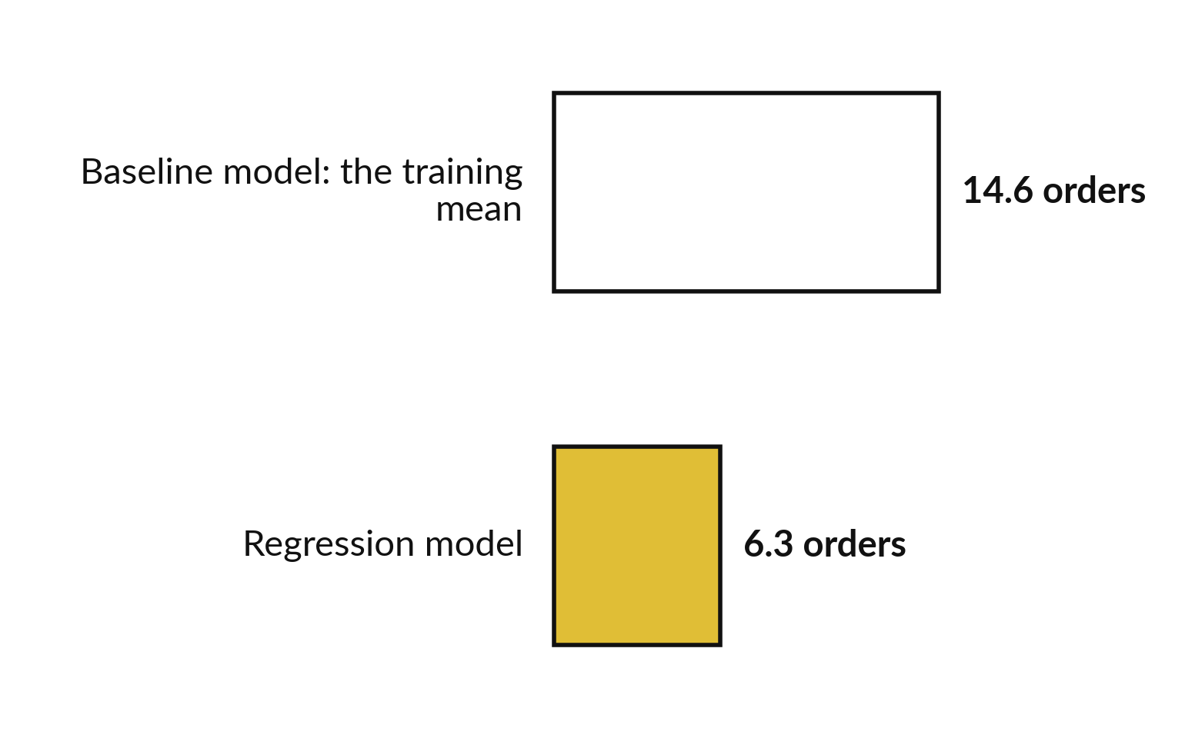
Prediction: on 208 records it never saw, the regression
misses by 6.3 orders and the baseline model by 14.6
RMSE on the test set: the typical miss on weeks the model never saw.
Training set: 624 records, 2024-01-01 to 2025-06-23.
Test set: 208 records, 2025-06-30 to 2025-12-22.
Baseline model: predict the training mean (35.7) every time.
Notes:
Explaining is one job. Predicting is another, and it needs a different check. To predict, you score the model on records it never saw. We fit the model on the first seventy-eight weeks, 624 records, which is the training set. Then we predict the last twenty-six weeks, 208 records, the test set.
Splitting by date like this is a time-based split. The baseline model predicts the training mean every time and misses by 14.6 orders. The regression misses by 6.3, close to its training miss of 6.0, and its R squared on the test set is 0.81. Why must the test weeks stay out of the fitting?

Slide 21
Explanation and prediction are two
jobs with two ways to check the model
Explanation
Prediction
How much does the target change when a predictor changes?
Read the coefficients and intervals.
Check the residual plot.
What will the target be for a new record?
Score the model on records it never saw.
Beat the baseline model.
Say which job you are doing before you fit the model.
Notes:
Keep the two jobs apart. Explanation asks how much the target changes when a predictor changes. You read coefficients and intervals, and you check the assumptions with a residual plot. Prediction asks what the target will be for a new record. You do not care how pretty the coefficients are.
You score the model on records it never saw, and you check that it beats the baseline model. A model can do one job well and the other badly. A manager who asks for a forecast needs prediction. A manager who asks whether the promotion works needs explanation.
Which job is your own project?

Slide 22


A coefficient depends on the other predictors in the model:
promotion is 5.61 alone and 6.80 with footfall and rain
Model | promo_on coefficient | rainfall_mm coefficient
promo_on alone | 5.61 | not in the model
promo_on, footfall and rainfall_mm | 6.80 | -0.118
rainfall_mm alone | not in the model | -0.125
Promotion weeks had slightly lower footfall (1,833 people against 1,910), so footfall hides part of the promotion effect. Rain and footfall are almost unrelated (correlation -0.004), so the rain coefficient hardly moves.
Notes:
Here is a warning about reading coefficients. The promotion coefficient is 5.61 when promotion is the only predictor, and 6.80 once footfall and rain are in the model. Promotion weeks had slightly lower footfall, 1,833 people on average against 1,910, so footfall hid part of the promotion effect.
Footfall is related both to the promotion and to orders, so leaving it out changes the promotion coefficient. When a variable is related to both a predictor and the target, it is a confounding variable, a confounder. Rain and footfall are almost unrelated, with a correlation of -0.004, so the rain coefficient barely changes, -0.125 against -0.118.
A coefficient always means: with the other predictors in this model held fixed. Why does that matter when two managers fit different models?

Slide 23
A coefficient shows an association,
and a cause needs more evidence
What the model supports
What it cannot show
Promotion weeks go with 6.8 more orders at the same footfall and rain.
Predicting a planned week.
That the promotion caused the extra orders.
Nobody randomised the promotion weeks, so a confounder could explain part of the gap.
A cause needs an experiment or strong evidence.
Notes:
This is the limit of regression. The model supports a statement about association: promotion weeks go with 6.8 more orders at the same footfall and rain. You can use that to predict orders for a planned week. It cannot show that the promotion caused the extra orders. The data does not say how the promotion weeks were chosen, and branches may have run promotions in weeks that were already going to be good.
In Session 12 the loyalty offer was randomised, which is why a lift there could be read as a cause. Here nobody randomised, so a confounder could explain part of the gap. What experiment would settle it?

Slide 24
Predict one week by hand: 2,000 people, a
promotion and 20 mm of rain gives 44.3 orders
Worked example with the fitted multiple linear regression model.
Question
A branch expects 2,000 people, a promotion week and 20 mm of rain. How many orders?
Working
2.378 + 0.01877 x 2,000 + 6.799 x 1 - 0.1183 x 20 = 44.35
Answer
About 44 orders. The same week without a promotion gives 37.5.
Check
2,000 lies inside the footfall range of the data (993 to 5,325). Outside that range the prediction is an extrapolation.
Notes:
Here is the model at work, by hand. A branch expects two thousand people, a promotion and twenty millimetres of rain. Start with the intercept, 2.378. Add 0.01877 times two thousand, which is 37.54. Add 6.799 for the promotion. Subtract 0.1183 times twenty, which is 2.37. The total is 44.35, about 44 orders.
Without the promotion it would be 37.5. Always check the inputs against the range of the data. Two thousand people is inside the range 993 to 5,325. Predicting for ten thousand people would be extrapolation, and the model has no evidence there. What input would you try next?

Slide 25



Where you will use this at work: put
a number on what moves your target
Your job | The question you can answer | The tool you would use
Retail analyst at a supermarket chain in Kampala | How many more orders does a promotion week bring at the same footfall? | Excel LINEST, or statsmodels in Python
Planning officer at a district health office | How do monthly clinic visits change with population and the season? | pandas and scikit-learn, results shared in Excel
Operations manager at a coffee cooperative | Illustrative: how do kilograms delivered change with rainfall and price? | Excel trendline first, then Python
Finance analyst at a bank | What explains branch deposits? One page of coefficients for the credit committee. | statsmodels summary, Power BI for the chart
Notes:
Where will you use this on Monday?
A retail analyst at a supermarket chain in Kampala can say how many more orders a promotion week brings at the same footfall, with Excel LINEST or statsmodels. A planning officer at a district health office can relate monthly clinic visits to population and season, using pandas and scikit-learn and sharing the result in Excel.
An operations manager at a coffee cooperative can start with an Excel trendline and move to Python. That example is illustrative. A finance analyst at a bank can put one page of coefficients in front of the credit committee, with a chart in Power BI. Which of these is closest to your job?

Slide 26

A good project question names the target,
the predictors, the data and the decision
Weak question | Better question | What it names
Is our data interesting? | Which of footfall, promotion and rainfall best explain weekly orders at Lakeside Mart branches? | Target and predictors
Can we predict loans? | Can we predict which Nile Microfinance loans default, using only what is known when the loan is approved? | Target, data, timing
Will this help clinics? | How many visits should a district clinic plan for next month, and how wrong is the forecast likely to be? | Decision and error
My own question | What will I predict or explain, from which table, to help which decision? | Your turn
Notes:
Project milestone 2 also asks you to scope your course project. A weak question is a topic, such as is our data interesting. A better question names the target, the predictors, the data and the decision. For Lakeside: which of footfall, promotion and rainfall best explain weekly orders?
For Nile Microfinance: can we predict which loans default, using only what is known at approval?
For the clinics: how many visits should a district plan for next month, and how wrong is the forecast likely to be?
The last row is yours. Write your own version before you leave today. Which table would you use?

Slide 27
Read the recipe before the lab:
four lines fit a multiple regression
In plain words
cols = ['footfall', 'promo_on', 'rainfall_mm']
X = np.column_stack([np.ones(len(bw)), bw[cols]])
coef, *_ = np.linalg.lstsq(X, bw.orders, rcond=None)
residuals = bw.orders - X @ coef
print(*coef.round(4))
Line 1 names the three predictors.
Line 2 adds a column of ones, which carries the intercept, to make the matrix X.
Line 3 solves ordinary least squares. coef holds the intercept, then one coefficient for each predictor.
Line 4: the residuals are actual minus predicted.
2.3785 0.0188 6.7986 -0.1183
Notes:
Before the lab, read the recipe. Line one names the three predictors. Line two adds a column of ones, which carries the intercept, and makes the matrix called X. Line three asks NumPy to solve ordinary least squares against the orders. It returns the four coefficients: 2.3785 0.0188 6.7986 -0.1183.
Line four computes the residuals, actual minus predicted. In the lab you turn them into R squared, 0.7946. In the lab you also run the same model with the statsmodels library, using the formula orders tilde footfall plus promo on plus rainfall mm. It reports the same numbers.
Which line would you change to drop rainfall from the model?

Slide 28
Part 2: the regression lab
Close the slides. Open the notebook.
Notes:
That is the end of the ideas. Everything you need is on the slides you have just seen, and the notebook repeats each step. Open the notebook for Session 13 in Google Colab and run the first cell, which puts the data files next to it. In every step you predict first, then run, then read the output, then change one thing. Write your prediction before you run the cell.

Slide 29
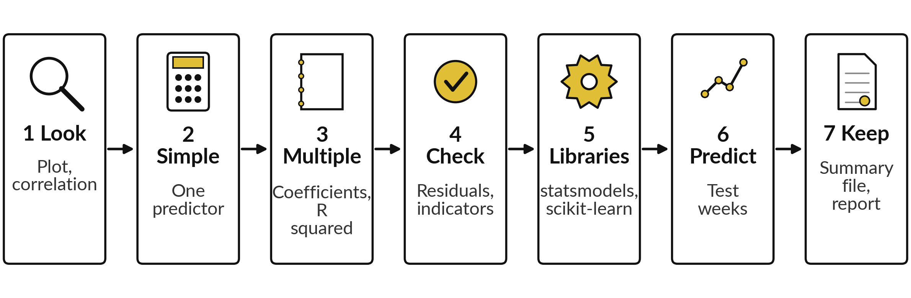
The lab has seven steps and ends with
a one page report and a summary file
Predict, run, read, change in each step. Checks tell you when your numbers match.
Notes:
Here is the map of the lab, in seven steps. Step one, look at the data with a scatter plot and a correlation. Step two, fit the simple regression with NumPy. Step three, fit the multiple regression, read the coefficients as sentences and compute R squared. Step four, check the residuals with a plot, add the branch indicators and meet the dummy variable trap.
Step five, run the same model in statsmodels and scikit-learn. Step six, predict one week and test on the last twenty-six weeks. Step seven, save the summary file and write your one page report. Each step has a predict prompt and a check. Please do not skip the predictions.

Slide 30








Check your numbers before you move on
What you compute | You should get
Records, and the correlation of orders with footfall | 832, and 0.84
Simple regression: intercept and coefficient of footfall | 1.23 and 0.0185
Multiple regression: intercept, footfall, promo_on, rainfall_mm | 2.38, 0.0188, 6.80, -0.118
R squared, and the RMSE (a typical size of a miss) | 0.795 and 6.1 orders
Residual standard deviation, lowest and highest third of predictions | 5.2 and 7.2
R squared and adjusted R squared with 7 branch indicators | 0.796 and 0.793
Matrix rank with the intercept and all 8 indicators | 8 (9 columns)
Test RMSE: baseline model and regression | 14.6 and 6.3
If your number differs, find the step that went wrong. Do not change a number to match.
Notes:
Use this table as your own self-check. Nobody marks it. If your numbers match, carry on. If one does not, stop and call me, because later steps use the earlier ones. The most common causes are a missing column of ones in the matrix X, which changes every coefficient, and fitting on the wrong rows when you split by date.
Do not change a number to make it match. Find out why it is different. If your R squared is higher than the table says, what could you have done differently?

Slide 31

Five likely mistakes in the lab and how to fix them
What you see | What it means | What to do
The intercept is missing, or the numbers are far from the table | X has no column of ones. | Add np.ones(len(bw)) as the first column of X.
A ValueError about shapes | X and y have different lengths, or a column is missing. | Print X.shape and y.shape. The rows must match.
Huge coefficients, or a statsmodels multicollinearity note | All 8 indicators and the intercept: the dummy variable trap. | Use drop_first=True. Check np.linalg.matrix_rank.
The residual plot shows a wedge | That is the heteroscedasticity from the residual plot slide. | It is a finding. Write it in your report.
statsmodels gives a column named Intercept | The formula adds an intercept for you. | Do not add a column of ones in the formula version.
Notes:
Five messages you may meet. If the intercept is missing or the numbers are far off, X has no column of ones, so add it as the first column. A ValueError about shapes means X and y have different lengths, so print both shapes. Huge or unstable coefficients, or a multicollinearity note from statsmodels, mean you kept all eight indicators together with the intercept, which is the dummy variable trap, so use drop first and check the matrix rank.
A wedge in the residual plot is a finding, so write it in your report. And the statsmodels formula adds the intercept for you, so do not add a column of ones there. Read the message first. It usually tells you the answer.

Slide 32


Your Project milestone 2 keepsake: a one page
analysis report written from your notebook
Section | What you write | Where it comes from
Question | One sentence naming the target, the predictors and the decision. | The project question slide and your notebook
Model | The multiple regression and the unit of every predictor. | Notebook step 3
Findings | Three coefficients as sentences, with intervals, and R squared. | Notebook step 7: regression_summary.csv and .xlsx
Check | What the residual plot showed and what you would do about it. | Notebook step 4
Limits | What the model cannot prove, and the test RMSE against the baseline. | Notebook step 6
Notes:
This is what you keep. The one page analysis report has five parts. The question names the target, the predictors and the decision. The model states the multiple regression and the unit of every predictor. The findings are three coefficients written as sentences with their intervals, and the R squared.
The check says what the residual plot showed and what you would do about it. And the limits say what the model cannot prove, with the test error against the baseline model. The notebook writes the summary file for you, as csv and as an Excel file you can open in Excel or Power BI.
Last line: your project question. Which part will be hardest to write?

Slide 33
Exit check: three questions, then
compare with the short answers
Question | Short answer
The promo_on coefficient is 6.8. Say it as one sentence for a manager. | A promotion week has about 7 more orders than a week without one at the same footfall and rainfall. It shows an association.
A residual plot fans out to the right. What is the name of the problem, and what does it affect? | Heteroscedasticity. The spread of the errors grows with the prediction, so intervals for large predictions are too narrow.
Adding 7 branch indicators moved R squared from 0.795 to 0.796 and adjusted R squared from 0.794 to 0.793. Keep them? | No. They add almost nothing, and adjusted R squared fell.
Notes:
Last, the exit check. Three questions. Write your answers in your notes before you look at mine. One, the promotion coefficient is six point eight: say it as one sentence for a manager. Two, a residual plot fans out to the right: what is the problem called and what does it affect?
Three, seven branch indicators moved R squared from point seven nine five to point seven nine six, and adjusted R squared fell: do you keep them?
The short answers are on the slide. If you got all three, you are ready for Session 14. If one surprised you, look at that step of your notebook again tonight.

Slide 34
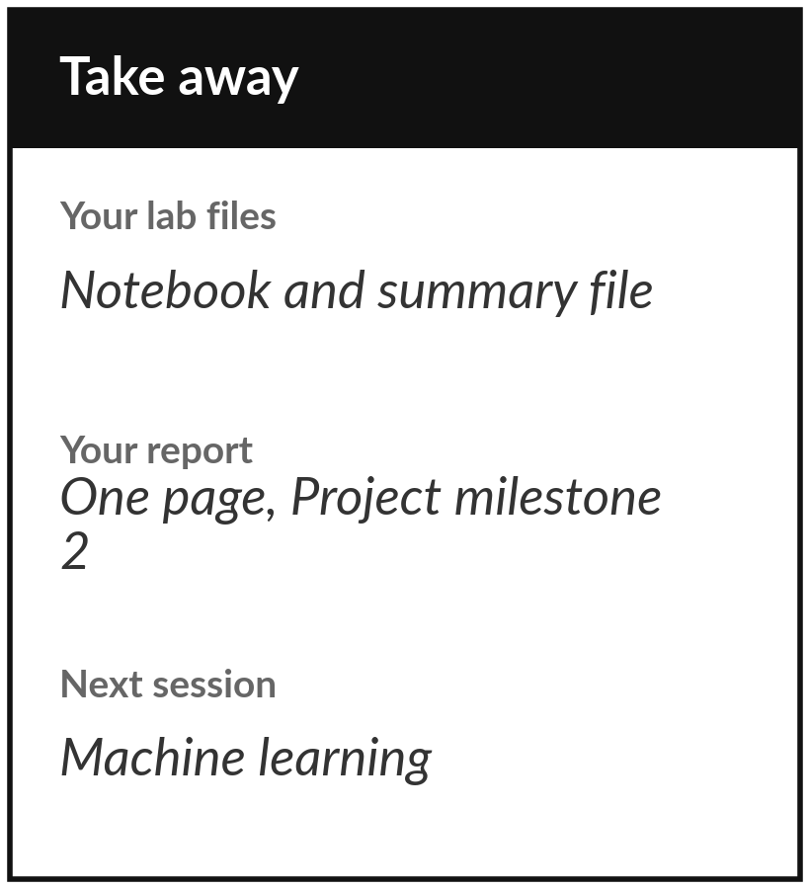
Save your notebook, your
summary file and your report
What you keep from today
Keep your notebook and regression_summary.csv, and write your one page analysis report: the question, the model, three coefficients as sentences, R squared, the residual check and what the model cannot prove.
Our question today
How much does one thing change when another changes, and how well can a model predict it?
Next session
Session 14: Machine learning, the workflow. We predict loan default with a train and test split.
Notes:
Before you go, save the notebook and the file regression summary dot csv. Together with your one page report they are your Project milestone 2. You show it to me for feedback, and nobody scores it. The report states the question, the model, three coefficients written as sentences, the R squared, what the residual plot showed, and what the model cannot prove.
Also write your project question on the last line. Next session we use the same train and test ideas to predict loan default, which is a yes or no instead of a number.
We began with this question: How much does one thing change when another changes, and how well can a model predict it? Before you go, say in one sentence what you can now say about it.

